Slide 1
Installing R,R Studio,and Packages

Slide 2



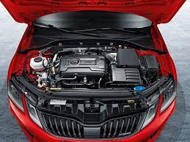


Slide 3
Install R and RStudio
To install R and RStudio on windows, go through the following steps:
Install R on windows
Step – 1: Go to CRAN R project website.
https://cran.r-project.org/

Slide 4
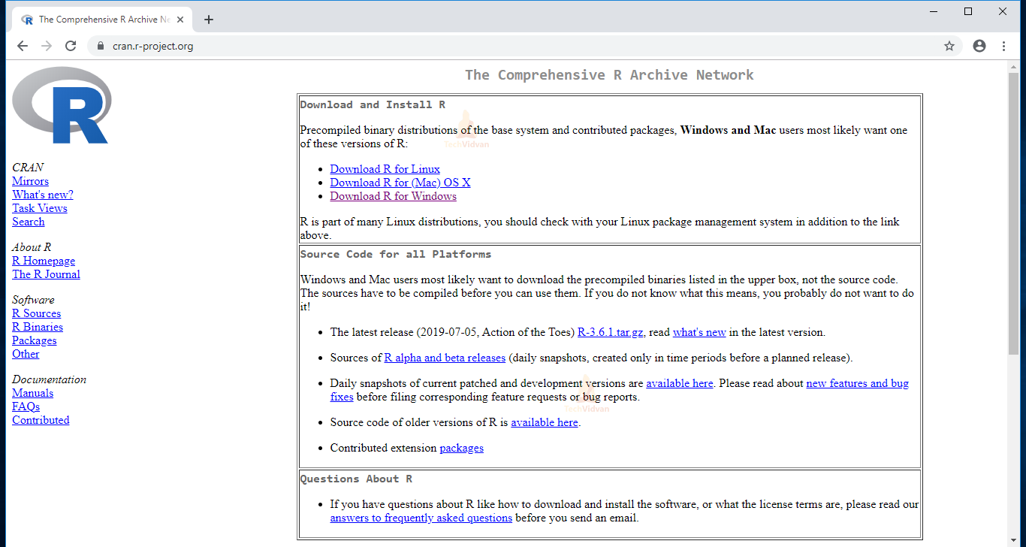
Install R
Download R for Windows

Slide 5
Install R
Step – 2: Click on the Download R for Windows link.
Step – 3: Click on the base subdirectory link or install R for the first time link.
Step – 4: Click Download R X.X.X for Windows (X.X.X stand for the latest version of R. eg: 3.6.1) and save the executable .

Slide 6
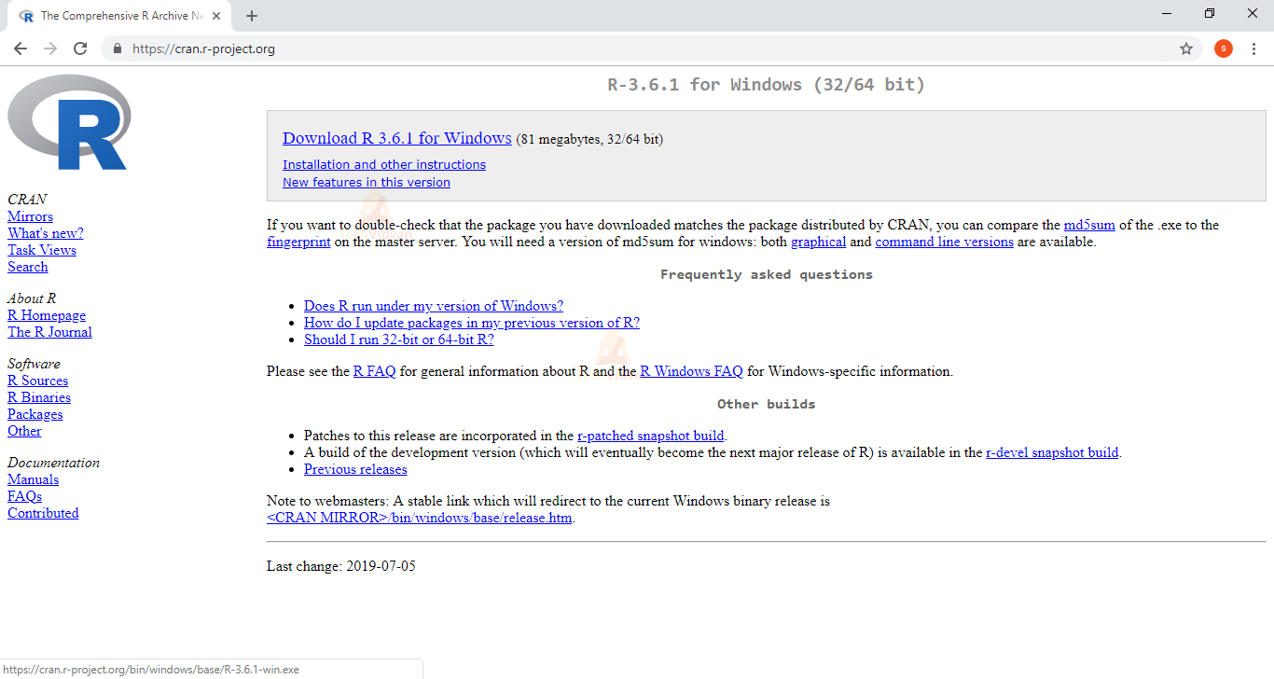
Install R

Slide 7
Install R and RStudio
Step – 5: Run the .exe file and follow the installation instructions.
5.a. Select the desired language and then click Next.

Slide 8
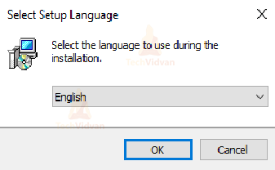
Install R

Slide 9
Install R and RStudio
5. Read the license agreement and click Next.

Slide 10
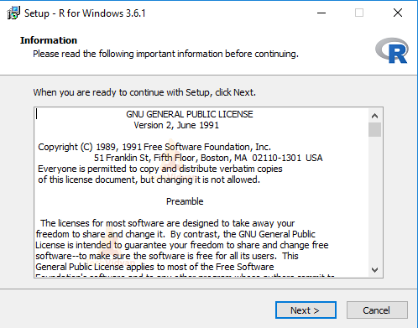
Install R and RStudio

Slide 11
Install R and RStudio
c. Select the components you wish to install (it is recommended to install all the components). Click Next.

Slide 12
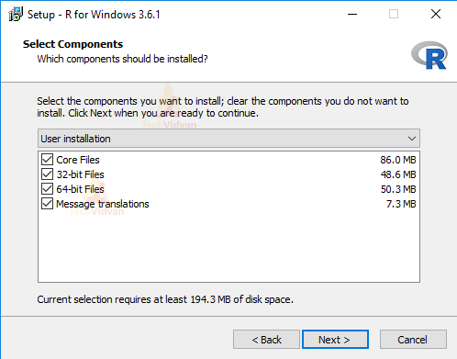
Install R

Slide 13
Install R
5.d. Enter/browse the folder/path you wish to install R into and then confirm by clicking Next.

Slide 14
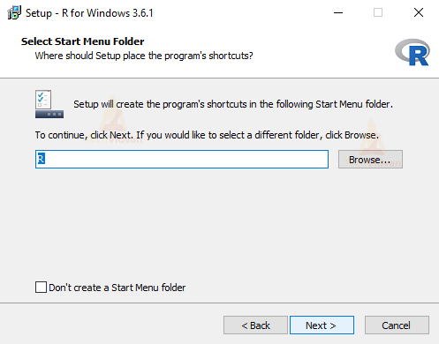
Install R

Slide 15
Install R
5.e. Select additional tasks like creating desktop shortcuts etc. then click Next.

Slide 16
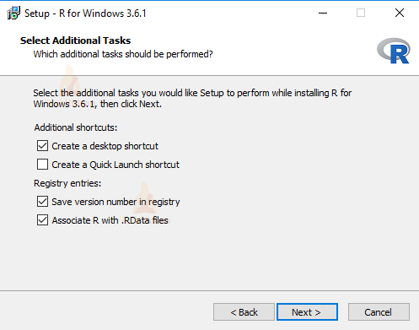
Install R

Slide 17
Install R
5.f. Wait for the installation process to complete.

Slide 18
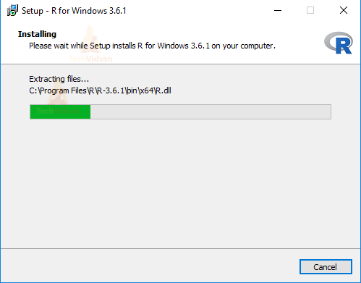
Install R

Slide 19
Install R
5.g. Click on Finish to complete the installation.

Slide 20
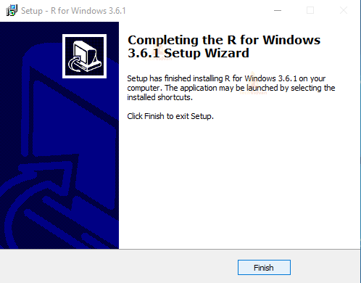
Install R

Slide 21
Install R Studio
Install RStudio on Windows
Step – 1: With R-base installed, let’s move on to installing RStudio.
To begin, go to download RStudio and click on the download button for RStudio desktop.

Slide 22
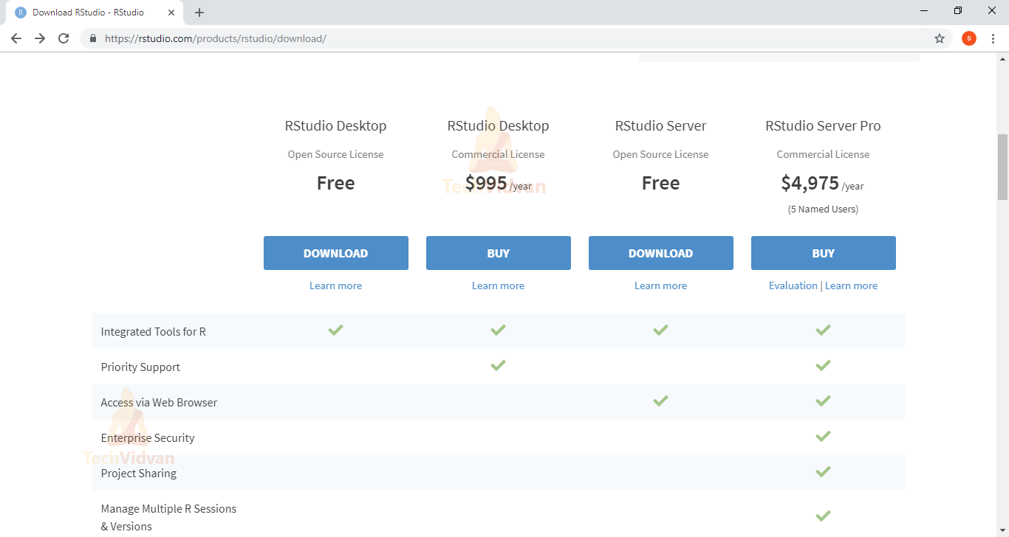

Slide 23
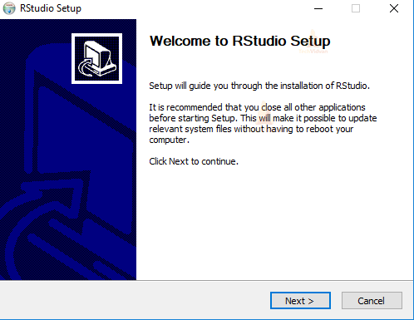
Install R Studio

Slide 24
Install R Studio
3.b. Enter/browse the path to the installation folder and click Next to proceed.

Slide 25
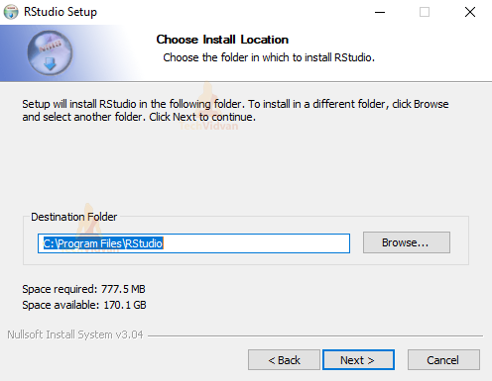
Install R Studio

Slide 26
Install R Studio
3.c. Select the folder for the start menu shortcut or click on do not create shortcuts and then click Next.

Slide 27
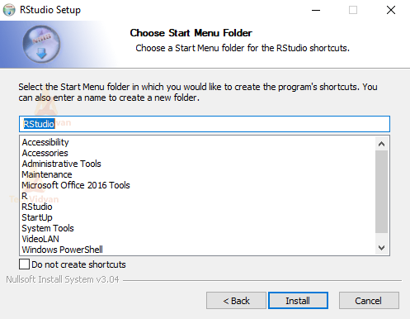
Install R Studio

Slide 28
Install R Studio
3.d. Wait for the installation process to complete.

Slide 29
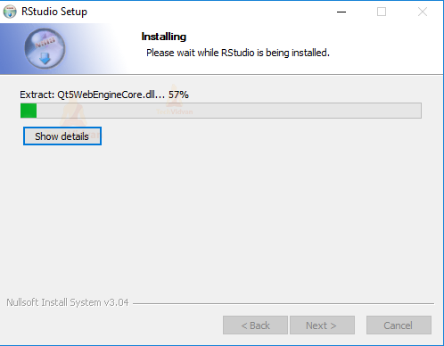
Install R Studio

Slide 30
Install R Studio
3.e. Click Finish to end the installation.

Slide 31
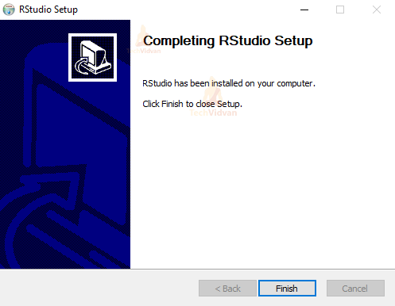
Install R Studio

Slide 32
Installing R and RStudio on Mac OS X
To install R and RStudio on Mac OS X, go through the following steps:
Install R on Mac
Step – 1: Go to CRAN R Project Website.
Step – 2: Click on the Download for (Mac) OS X link.
Step – 3: Click on the link for the pkg file of the latest R version and save it.
Step – 4: Double click the downloaded file and follow installation instructions.

Slide 33
Installing R and RStudio on Mac OS X
Install RStudio on Mac OS X
Step – 1: With the r-base installed, you need to install RStudio.
To do that, go to download RStudio and click on the download button for the RStudio desktop.

Slide 34
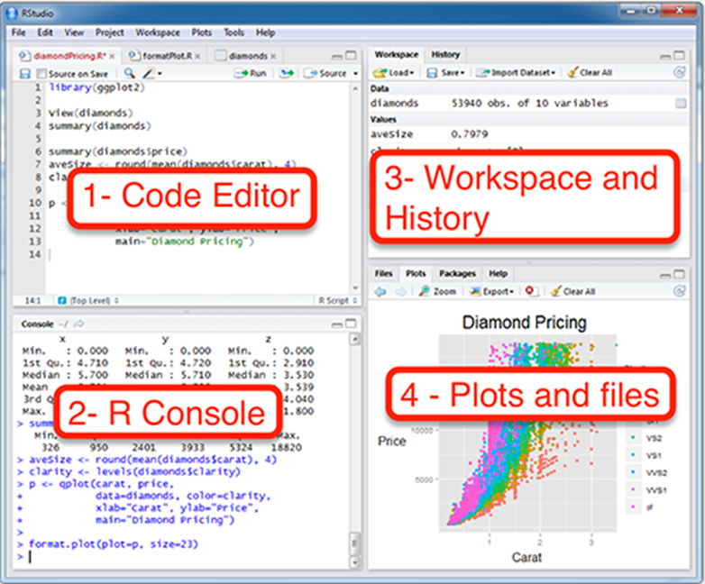
R Studio

Slide 35
R Studio
RStudio is a four pane work-space for
Creating file containing R script,
Typing R commands,
Viewing command histories,
Viewing plots and more.
Top-left panel: The R script is where you keep a record of your work. R script can be created as follow: File –> New –> R Script.

Slide 36
R Studio
Bottom-left panel: R console for typing R commands
Top-right panel:
Workspace tab: shows the list of R objects you created during your R session
History tab: shows the history of all previous commands

Slide 37
R Studio
Bottom-right panel:
Files tab: show files in your working directory
Plots tab: show the history of plots you created. From this tab, you can export a plot to a PDF or an image files
Packages tab: show external R packages available on your system.

Slide 38
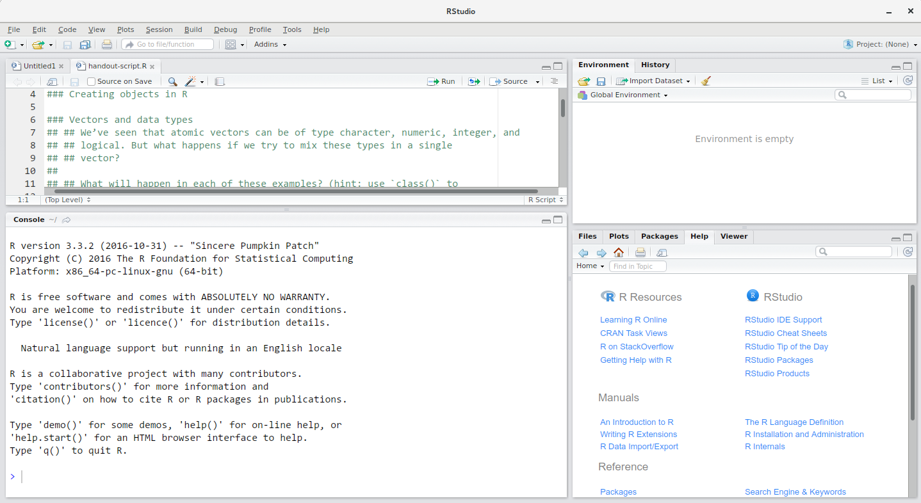

Slide 39
Packages
Packages in R Programming language are a set of R functions, compiled code, and sample data.
These are stored under a directory called “library” within the R environment.
Once we start the R console, only the default packages are available by default

Slide 40
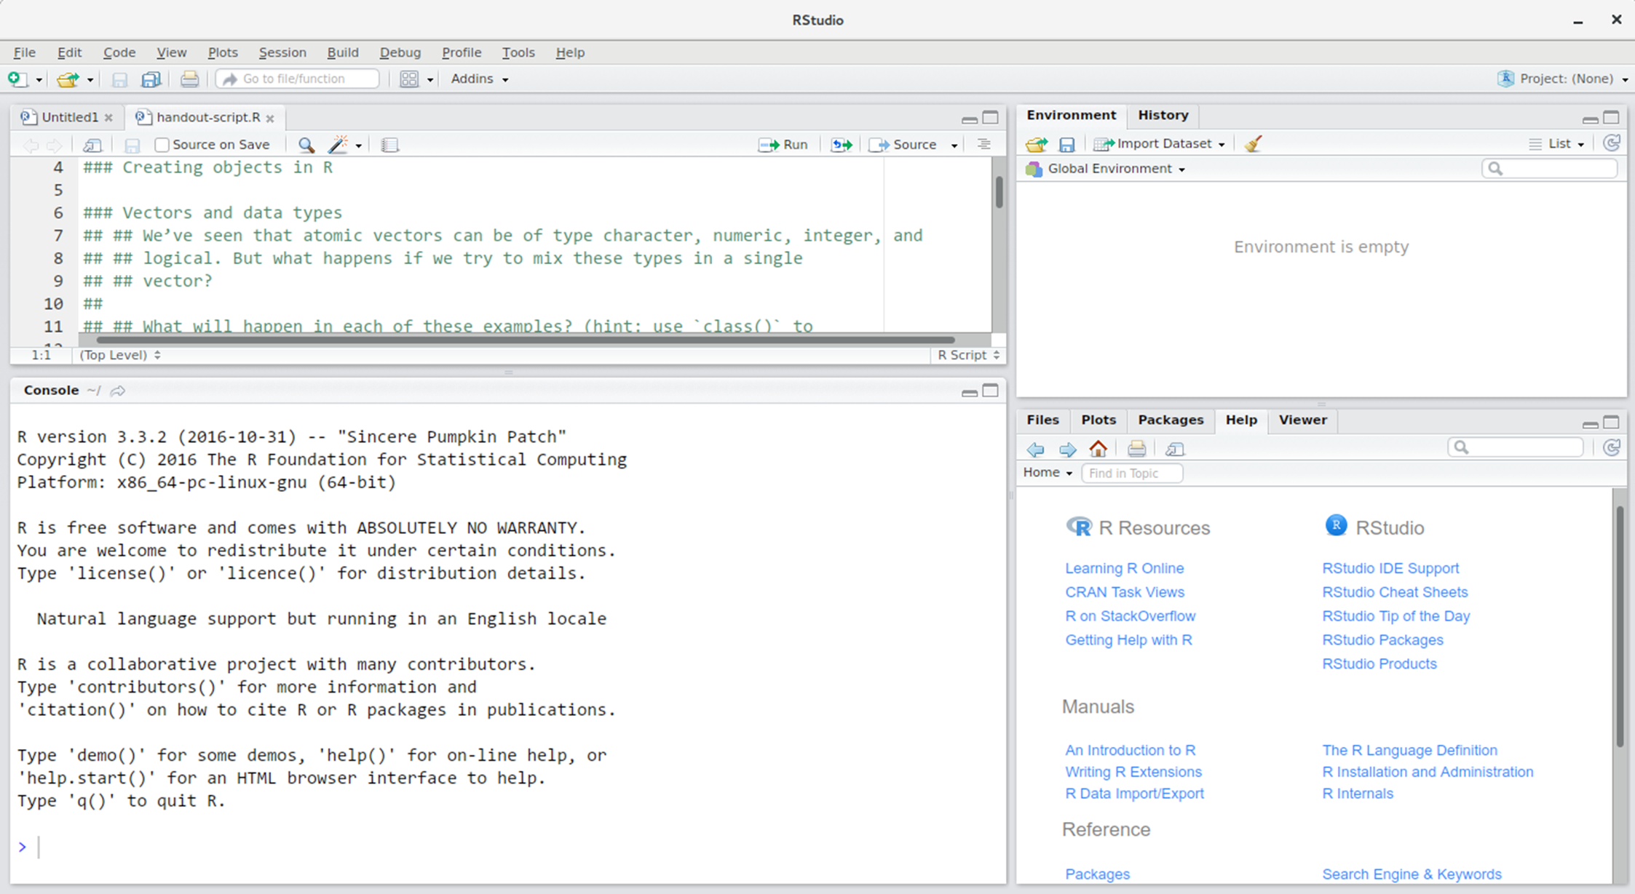
Packages

Slide 41
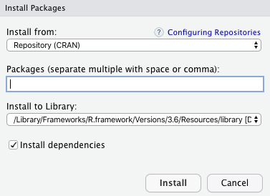
Packages

Slide 42
Packages
library(): It is the command used to load a package, and it refers to the place where the package is contained, usually a folder on our computer.
Package: It is a collection of functions bundled conveniently. The package is an appropriate way to organize our own work and share it with others.

Slide 43
Packages
install.packages("ggplot2")
You can easily load the package ggplot2 by using the following syntax:
library(ggplot2)

Slide 44
Packages
ggplot2 is based on the 'Grammar of Graphics", which is a popular data visualization library.
Graphs with one variable, two variables, and three variables, along with both categorical and numerical data, can be built.
Also, grouping can be done through symbol, size, color, etc.

Slide 45
Packages
tidyr
tidyr helps to create tidy data.
Basically, tidy data consists of those datasets where every cell acts as a single value, where every row is an observation, and every column is variable.
You can install tidyr using the following command.
install.packages("tidyr")

Slide 46
Packages
Tidyverse packages
Installation and use
Install all the packages in the tidyverse by running
install.packages("tidyverse")
Run library(tidyverse) to load the core tidyverse and make it available in your current R session.

Slide 47

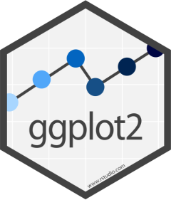

Packages
Tidyverse’s core package contains packages like:
ggplot2, dplyr, tidyr, readr, purrr, tibble, stringr, and forcats.

Slide 48


